Slide 1

Capstone Project
HR Payroll System
Name :Abhishek Kumar Yadav
Superset ID : 3196046

Slide 2



Contents
Project Overview | 4
Project Structure | 5
Feature Files | 6
Runner Class | 9
Step Definitions POM Class Utility Class | 10 11 13
Base Class | 15
Report Class | 16
Extent Reports | 17
Project Config & Build Mngt | 20
Console Output GIT Screenshots | 21 23 24

Slide 3

Project Overview
This project automates the OrangeHRM application using a scalable Selenium Java framework with Cucumber BDD, TestNG, and Maven, providing reusable utilities, data-driven testing, cross-browser support, and professional reporting.
Project Link - abhishekyadu/hrpayrol
fff

Slide 4
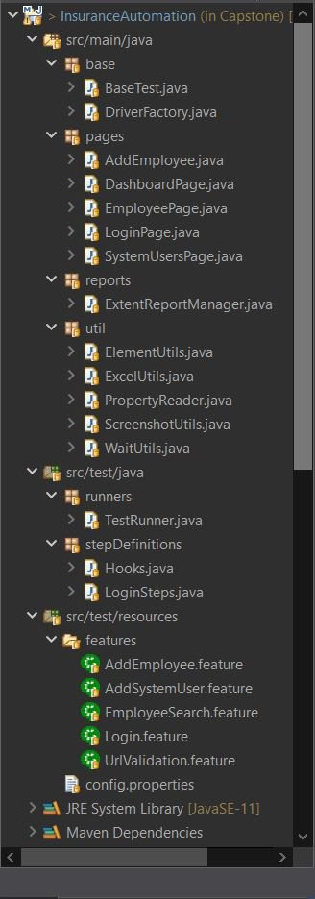
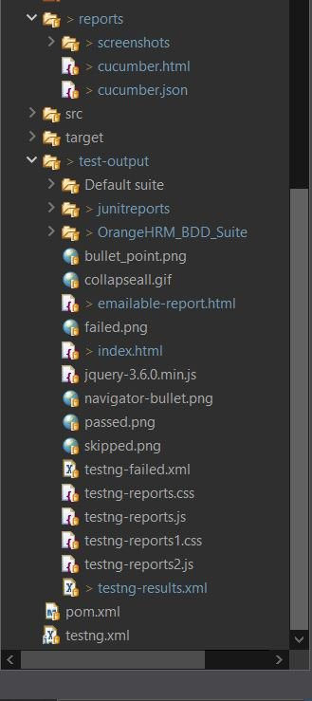
Project Root:

Slide 5

Feature Files
1. URL Validation
Correct URL → Redirect to login page
Wrong URL → Page not found error
2. Login Functionality
Positive: Correct credentials → Dashboard displayed
Negative: Invalid credentials → Login error

Slide 6
3. Add the Employee
Positive Testcase: Launch app → Login → Add employee → Verify success
Negative Testcase: Missing required fields → Verify error
4. Search Employee
Positive: Search by ID → Verify record found
Negative: Search invalid ID → Verify no record found
5. Add System User
Positive: Add new user with all details → Verify success
Negative: Missing required fields → Verify validation error

Slide 7
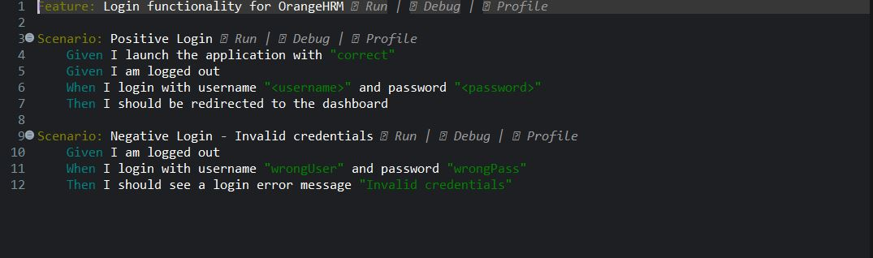
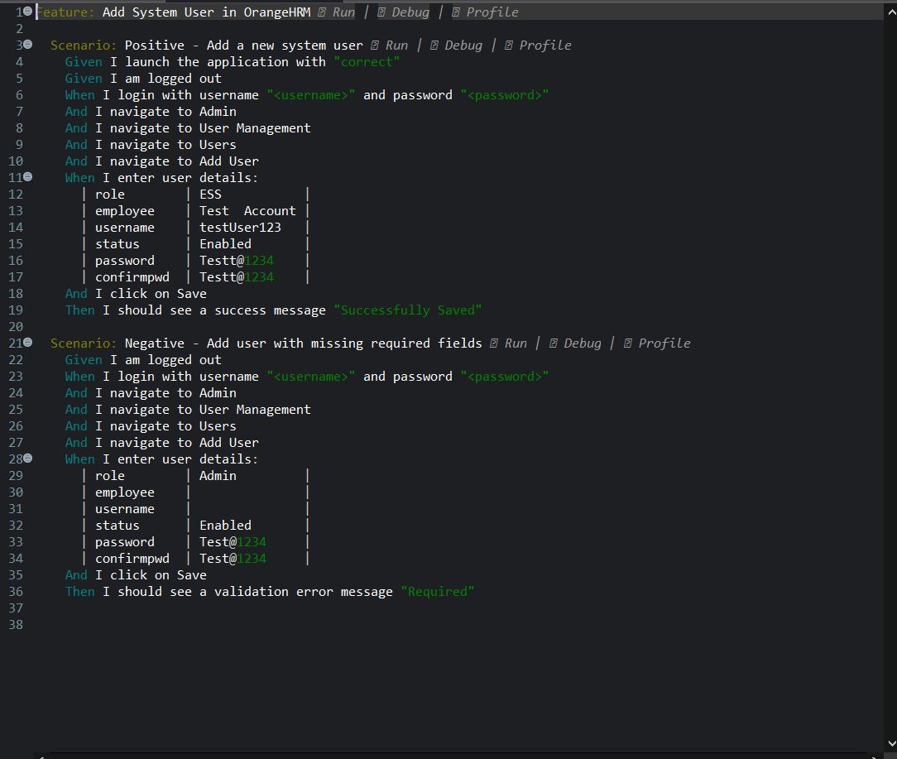
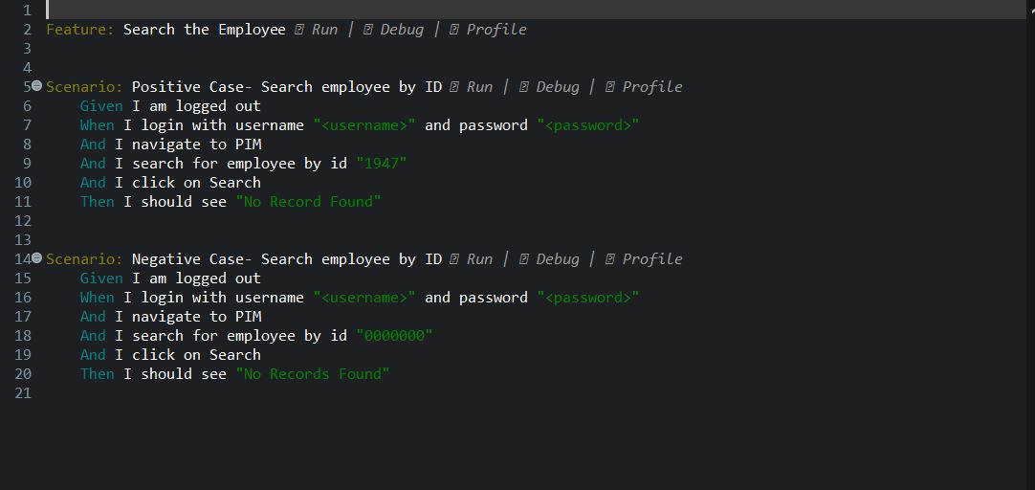
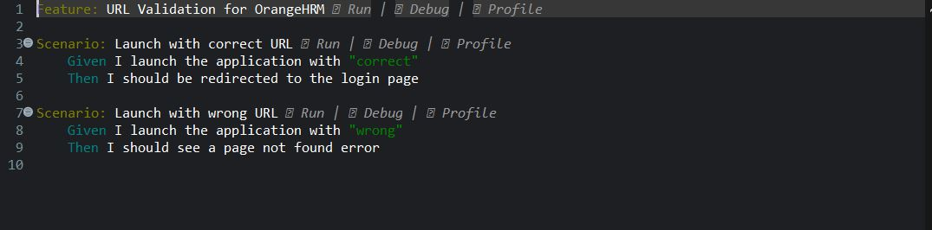
Feature Files (ScreenShots)

Slide 8

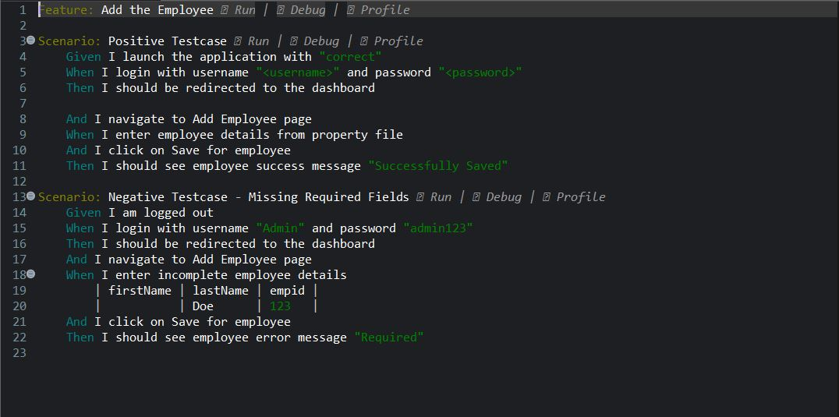

Slide 9

Runner class
ADD COMPANY NAME
The runner class executes all feature files, integrates Cucumber with TestNG, and generates automation reports.
TestRunner.java -
The TestRunner.java class integrates Cucumber with TestNG to execute all feature files in the project.
It specifies feature file locations, step definitions, and generates HTML and JSON reports for automation results

Slide 10
Step Definitions
Hooks.java
The Hooks class manages setup and teardown for all scenarios, initializing the WebDriver and opening the application URL before tests, and quitting the browser after tests.
It also integrates ExtentReports, capturing screenshots for each scenario and logging pass/fail status to generate professional reports.
LoginSteps.java
Contains all Cucumber step definitions for Login, Add Employee, Add User, and Employee Search features.
Interacts with Page Objects (LoginPage, DashboardPage, AddEmployee, SystemUsersPage, EmployeePage).
Uses ExtentReports for step logging and attaching screenshots.
Validates scenarios with TestNG assertions for both positive and negative cases.
Handles dynamic data from PropertyReader and Cucumber DataTables.
Ensures clean test state by logging out before scenarios.

Slide 11
Page Object Model (POM) class
ADD COMPANY NAME
Login.java
Represents the Login Page of OrangeHRM application.
Provides a reusable login() method for entering credentials and clicking login.
It has the fields for username, password, and login button.
Helps check if login was successful or if an error message is shown.
DashboardPage.java
Represents the Dashboard screen of the application in the Page Object Model (POM).
Contains locators for user menu and logout button.
Represents the Dashboard page that appears after a successful login.
Provides a method to verify if the user is logged in by checking the visibility of the user menu.
Includes functionality to log out of the application and wait until the login page is displayed again.

Slide 12
AddEmployee.java
Represents the Add Employee page inside the PIM module.
Provides methods to fill employee details and save them into the system.
Automates entering employee details like first name, middle name, last name, and employee ID.
Verifies if an employee is saved successfully by checking the success message.
EmployeePage.java
Represents the Employee Search page under the PIM module.
Provides methods to search employees by name or ID.
Includes functionality to verify search results, checking whether records are found or not.
SystemUsersPage.java
Represents the System Users page where new users can be added and managed.
Provides navigation methods to reach Admin → User Management → Users → Add User.
Includes functionality to add a new user with role, employee name, username, status, and password.
Offers methods to verify outcomes through success or error messages after saving a user.

Slide 13
ADD COMPANY NAME
Utility class
ElementUtils.java
Provides reusable helper methods like type, click, and dropdown selection to simplify Selenium actions.
Handles waits and visibility checks internally, ensuring tests run smoothly without flaky errors.
ExcelUtils.java
Provides a utility method to read data from Excel sheets, supporting data-driven testing.
Simplifies accessing cell values from a given sheet, row, and column.
Helps maintain separate test data files, making test scripts cleaner and reusable.
PropertyReader.java
Loads configuration and locator values from a .properties file, centralizing project settings.
Provides a simple method to retrieve property values using a key.
Helps make the automation framework flexible and maintainable without hardcoding URLs, credentials, or other configurations.

Slide 14
ScreenshotUtils.java
Captures screenshots of the current browser window during test execution.
Saves screenshots in a designated folder defined in the configuration file, with a default fallback path.
WaitUtils.java
Provides methods to wait for a single element to be visible before interacting with it.
Supports waiting for multiple elements to appear on the page simultaneously.

Slide 15
ADD COMPANY NAME
Base class
BaseTest.java
Provides a setup method to initialize the WebDriver and maximize the browser window before each test method.
Ensures proper cleanup by quitting the WebDriver after each test method.
Integrates with ExtentReportManager to flush test reports after execution.
DriverFactory.java
Maximizes the browser window and ensures a fresh WebDriver instance before each test.
Initializes and provides WebDriver instances for Chrome, Firefox, and Edge with language and browser-specific options.

Slide 16
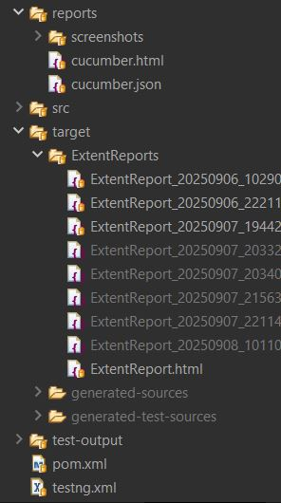
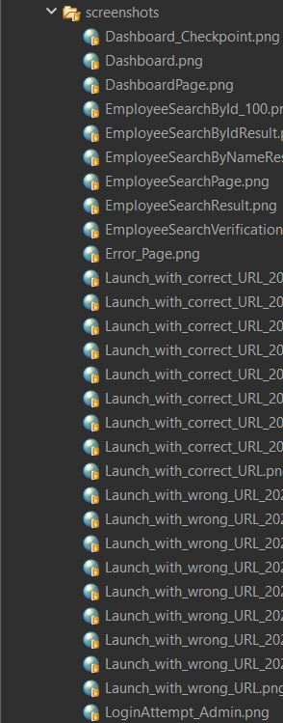
ADD COMPANY NAME
Report class
ExtentReportManager.java
Manages the creation and configuration of ExtentReports for test execution.
Creates timestamped HTML reports to ensure each test run has a unique report file.
Provides methods to create and retrieve individual test logs and flush reports to disk after execution.

Slide 17
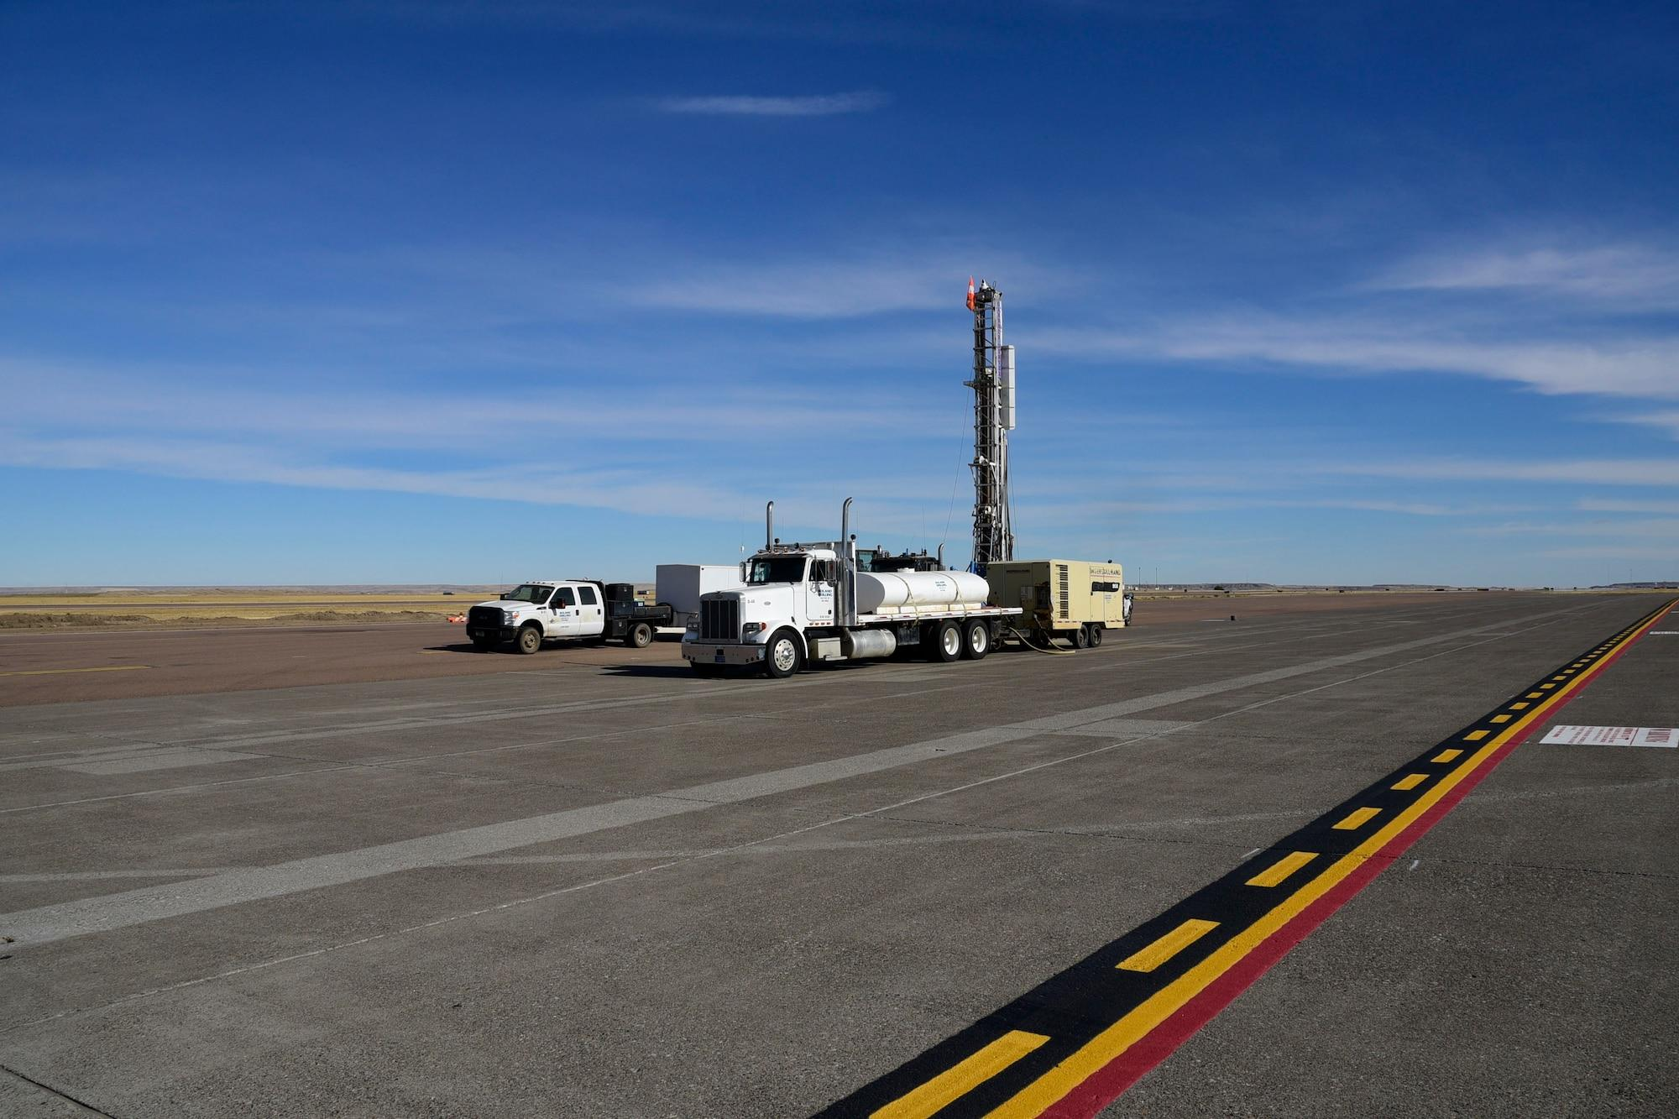
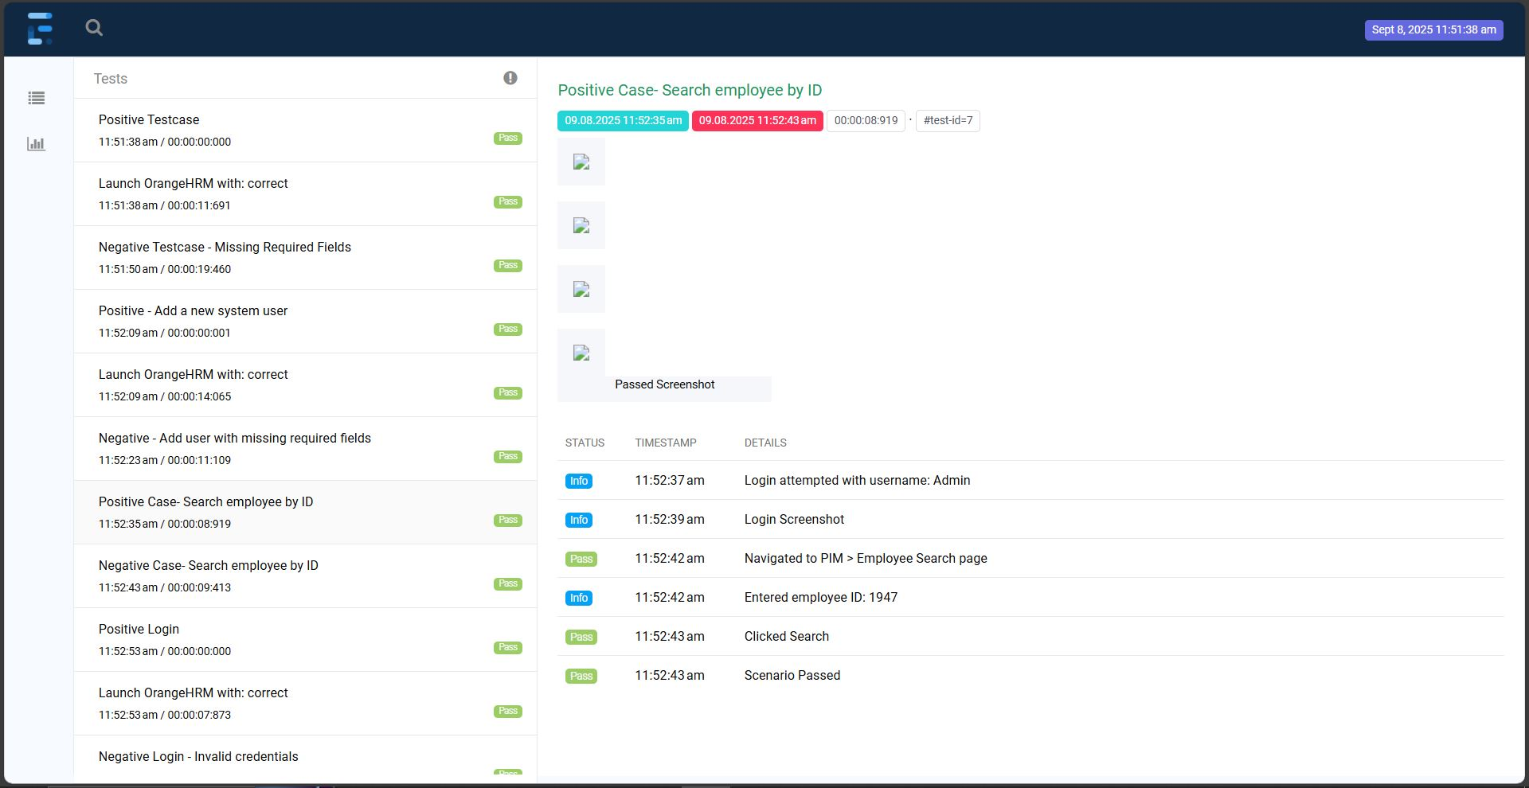
Extent Reports - I

Slide 18
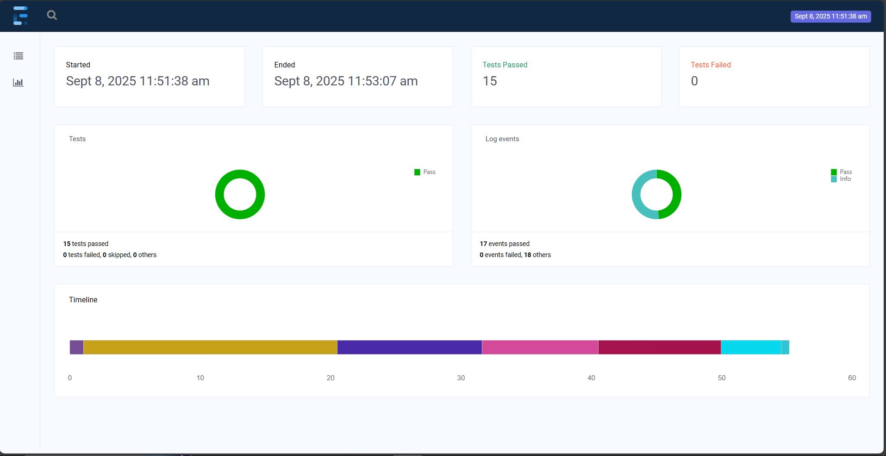
Extent Reports - II

Slide 19
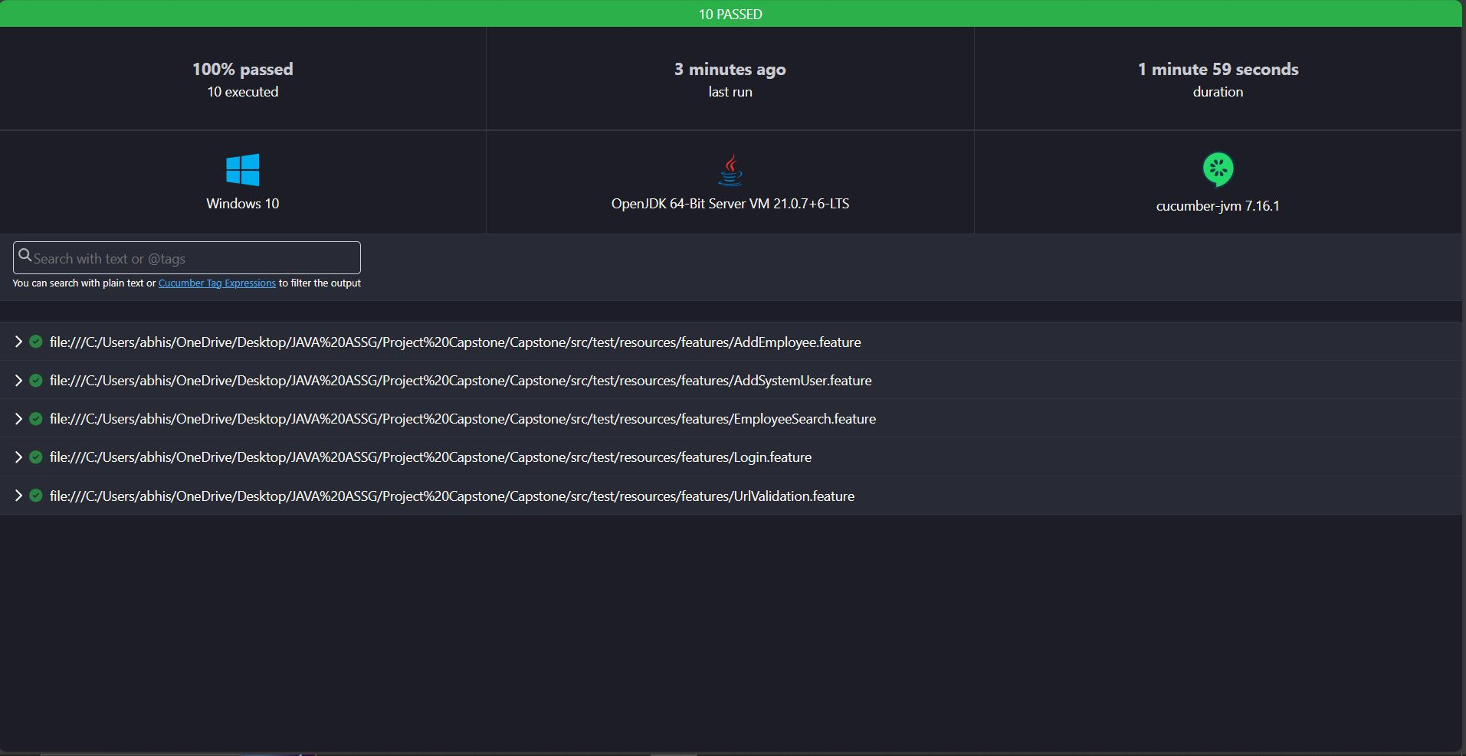
ADD COMPANY NAME
cucumber.html

Slide 20

ADD COMPANY NAME
Project Configuration & Build Management
Testng.xml
Defines the TestNG suite, specifying which classes or packages to run..
Ensures the Cucumber TestRunner is executed for all feature files.
pom.xml
Manages project dependencies, including Selenium, Cucumber, TestNG, Apache POI, and ExtentReports.
Configures Maven plugins for build, test execution, and report generation.

Slide 21
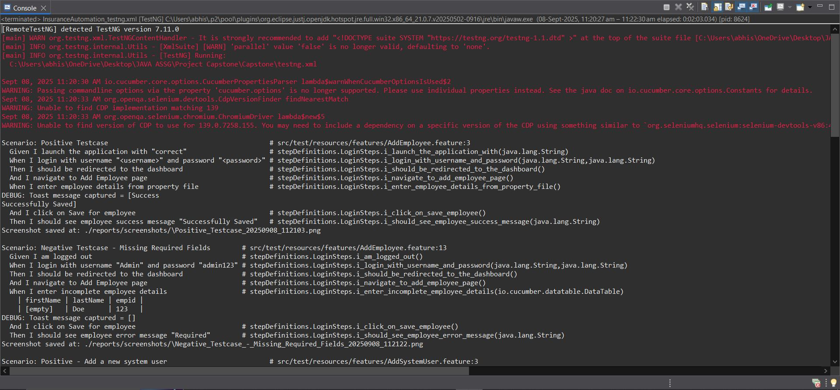
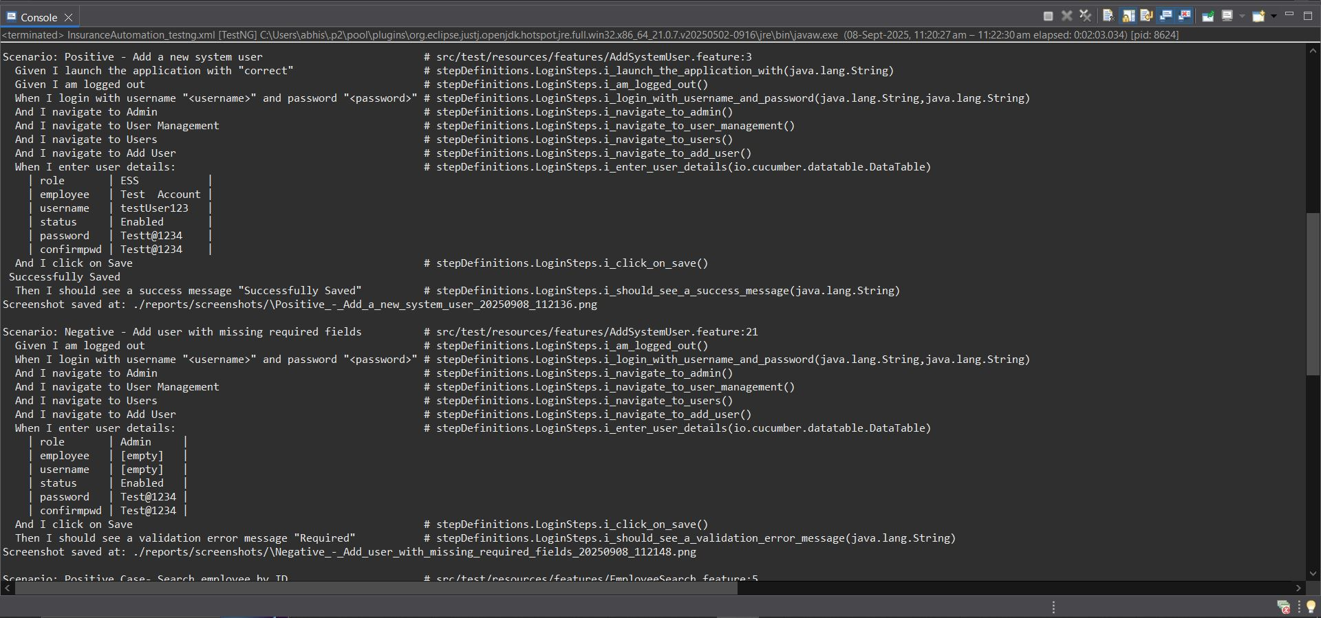
Console Output - I

Slide 22
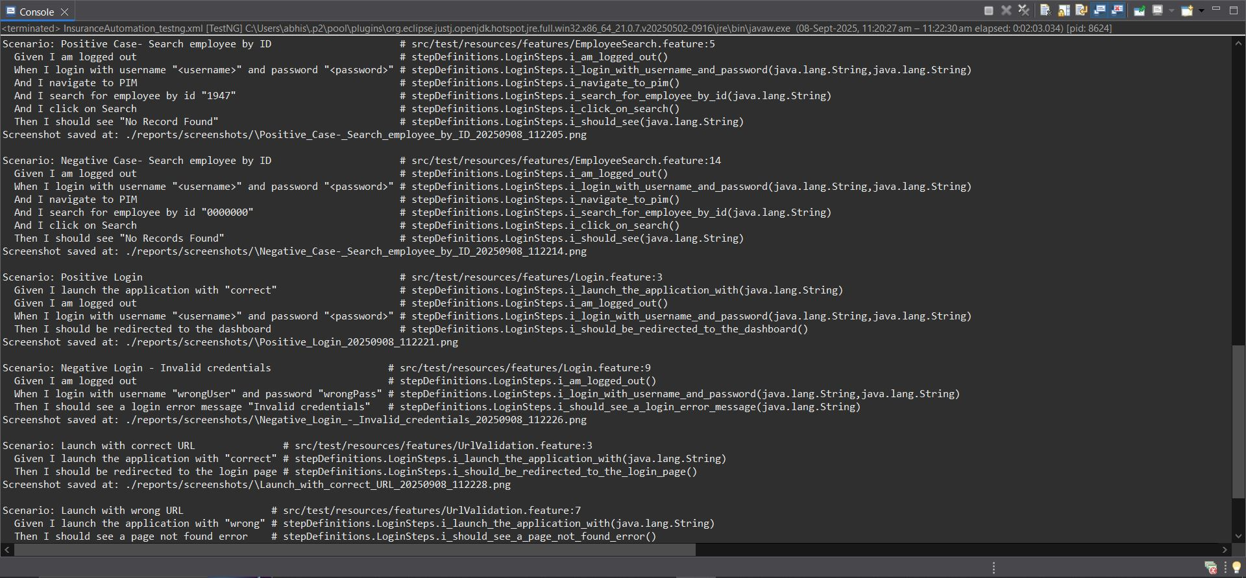

Console Output -II

Slide 23

GIT - Project Repository & Version Control
The complete project is hosted on GitHub for version control and collaboration.
Provides access to all feature files, POM classes, utilities, and test scripts.
Supports easy clone, pull, and push operations for updates.
Link to the repository: abhishekyadu/hrpayroll

Slide 24
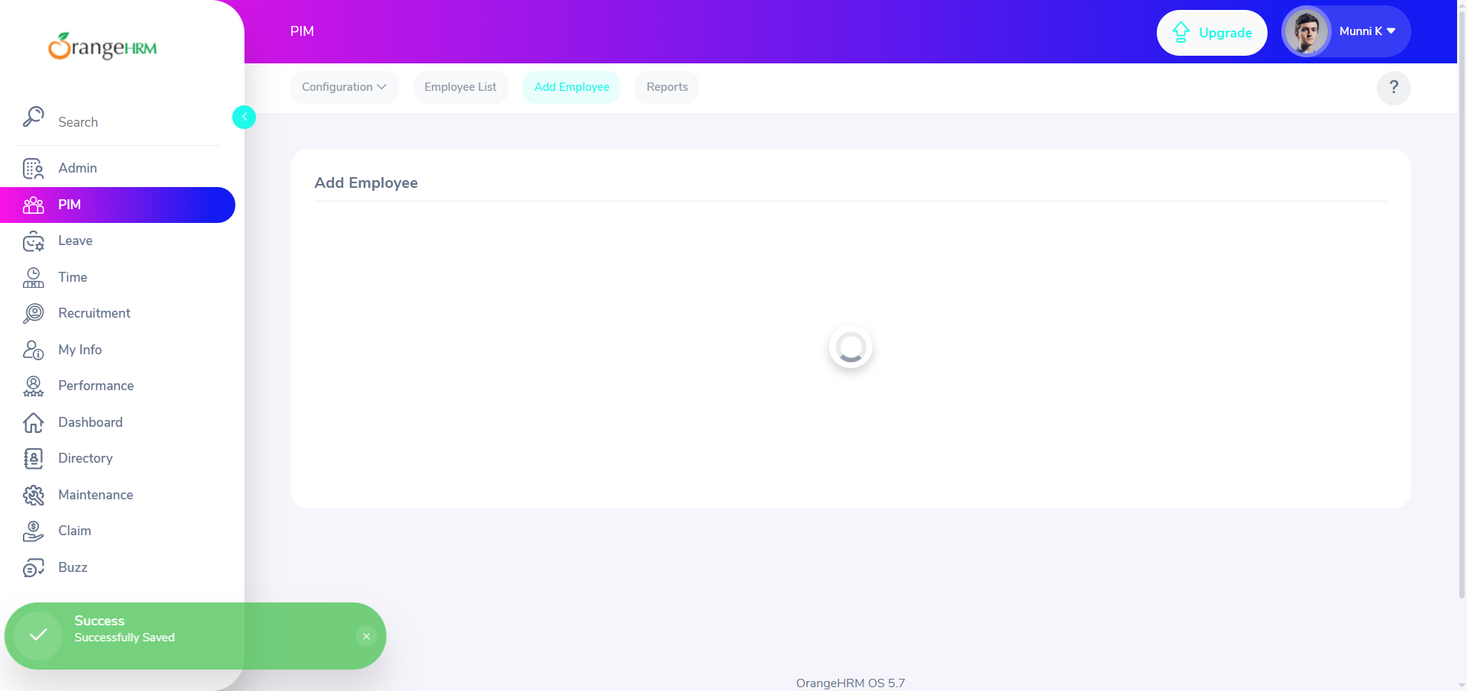
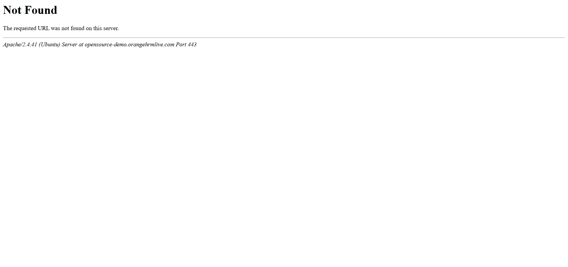
ADD COMPANY NAME
Screenshot - I
Testcase -1 : URL Validation
Positive Testcase
Negative Testcase

Slide 25
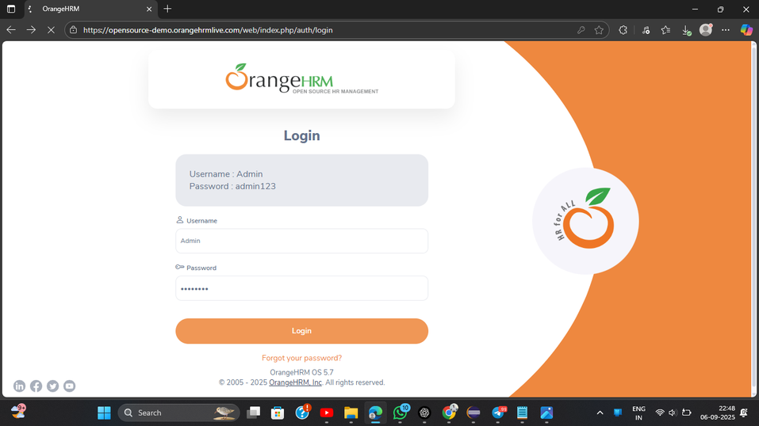
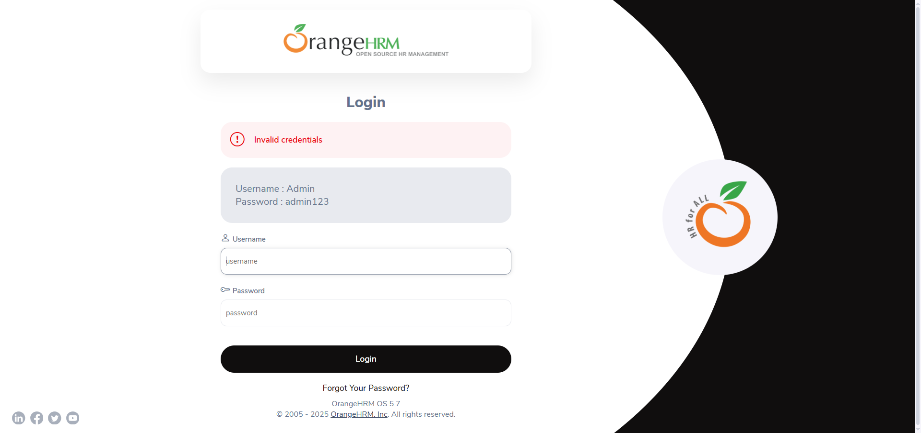
ADD COMPANY NAME
Screenshot - II
Testcase -2 : Login Functionality
Positive Testcase
Negative Testcase

Slide 26
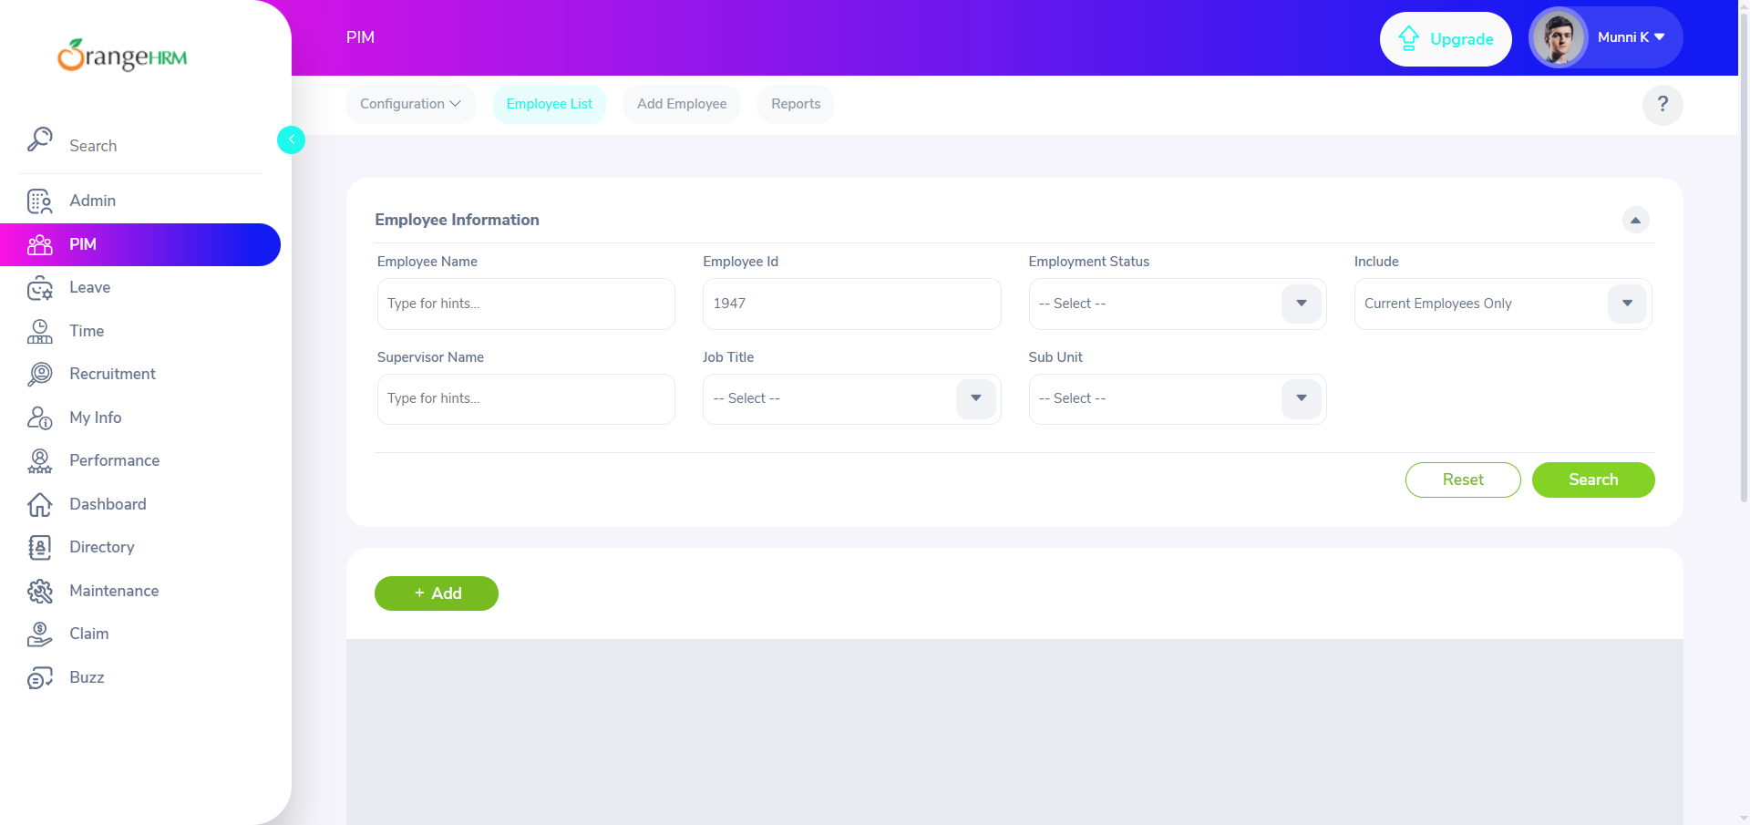
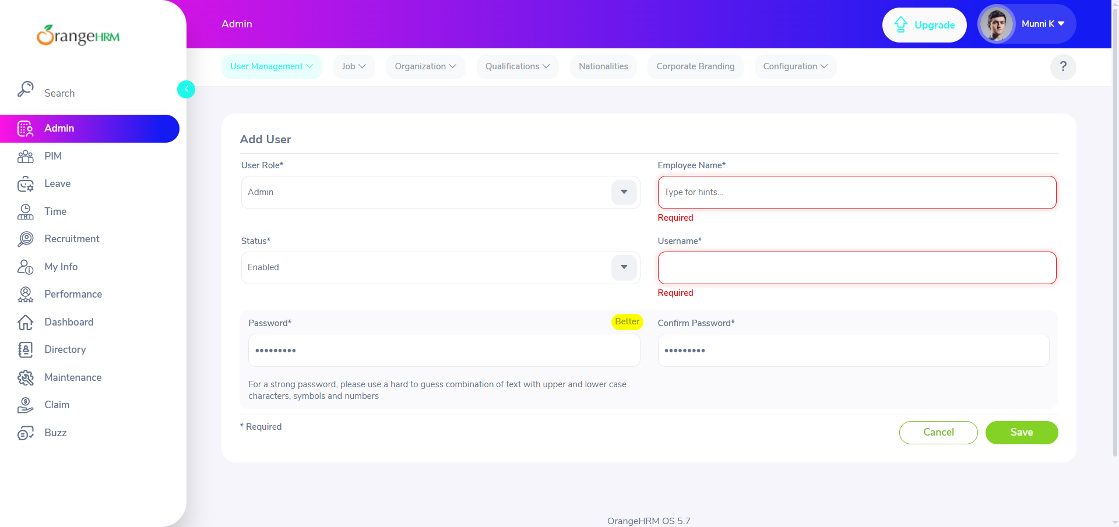
ADD COMPANY NAME
Screenshot - III
Testcase -3 : Add the Employee
Positive Testcase
Negative Testcase

Slide 27

ADD COMPANY NAME
Screenshot - IV
Testcase -4 : Search the Employee
Positive Testcase
Negative Testcase

Slide 28
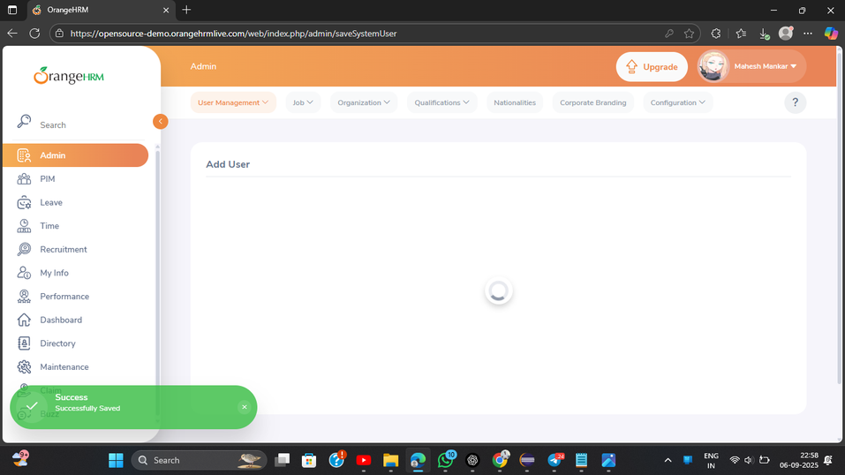
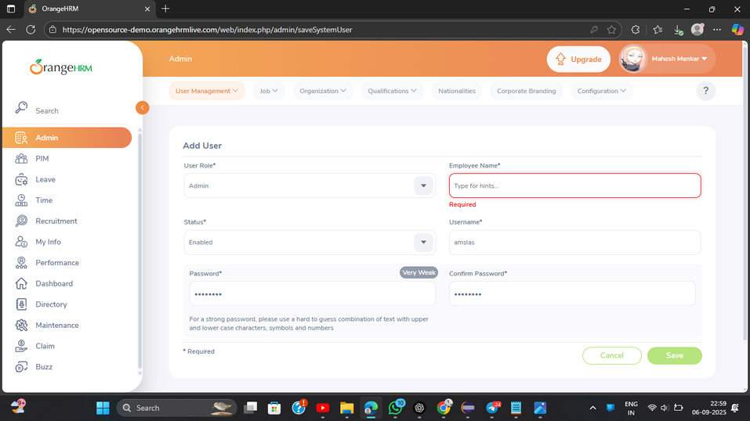
ADD COMPANY NAME
Screenshot - V
Testcase -5 : Add the User
Positive Testcase
Negative Testcase

